Slide 1


The Value of Discoverability and Design in
Direct-to-fan Platforms
Zijing “Jimmy” Hu
Arch H. Aplin III ’80 Department of Marketing
Mays Business School, Texas A&M University

Slide 2
Research Portfolio
 |  | Platform Design |  | Product Development
AI & Machine Learning |  | [1] [7] |  | [2] [4]
Reduced-form Model |  | [1] [6] |  | [2]
Structural Model |  | [1] |  | [4]
Analytical Model |  | [3] [5]
Zijing “Jimmy” Hu, Yan “Lucy” Liu. The value of discoverability and design in direct-to-fan platforms. (Job Market Paper: targeting Marketing Science)
Zijing “Jimmy” Hu, Venkatesh Shankar. Identifying and measuring sales-related underlying product attributes with a new deep learning approach. (Revise & Resubmit, Journal of Marketing Research)
Zijing “Jimmy” Hu, Xuying Zhao. Rejection design for crowdsourcing platforms.
(Accepted at BU Platform Symposium 2025/CIST 2026: targeting Journal of Marketing Research)
Zijing “Jimmy” Hu. Recovering true customer preferences through varying realization probabilities. (Targeting Marketing Science)
Markets for machine demand: API intermediation in the age of AI Agents
Enhancing eco-driving behaviors using offline reinforcement learning
Strategic communication for scientific forecasting

Slide 3
The Value of Discoverability and Design in
Direct-to-fan Platforms
Zijing “Jimmy” Hu
Arch H. Aplin III ’80 Department of Marketing
Mays Business School, Texas A&M University

Slide 4




Examples
1/36
1M+ projects;
millions of monthly users
300K+ creators; 10M+ paying members
$10B+ since 2013
$20B+ transaction volume
$1.76B paid to artists;
$223M spent last year

Slide 5
Market is Expanding Quickly
2/36
Stripe: cumulative creator payouts increased from $10 billion in 2021 to more than $25 billion in 2023
Patreon: the potential direct-to-fan market is about $194 billion in 2025 and could exceed $231 billion by 2027

Slide 6
Direct-to-fan Marketplace
Supply
A single category of cultural products
Small individual producers/designers/creators
Platform
Limited intermediary role
Demand
Consumers from cultural groups/communities

Slide 7
Discovery Challenge
4/36
53%
of creators say it is harder to reach their
followers today than five years ago (Patreon 2025)
47%
of game developers name discoverability and
user-acquisition as their largest obstacle (Unity 2026)

Slide 8
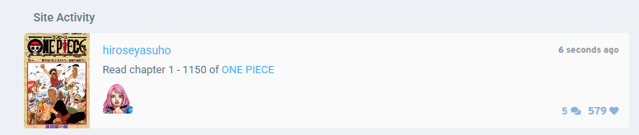
A Design Adopted by Some Platforms
5/36
Platforms use purchases to generate a live information feed
  Quickly updating
  Less algorithm-driven

Slide 9
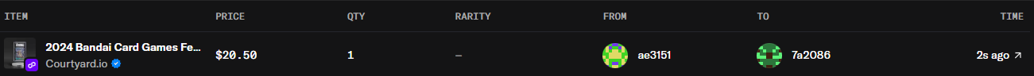
Different Designs of Discovery Channels
6/36
Uniform for everyone – platform-wide visibility

Slide 10
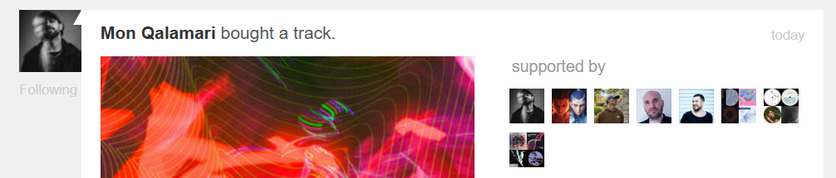
Different Designs of Discovery Channels
6/36
Uniform for everyone – platform-wide visibility
Filtered by user network – network-wide visibility

Slide 11
Research Questions
7/36
What is the effect of different discovery channels (i.e., platform-wide vs. network-wide visibility) on market outcomes (e.g., demand, market concentration, and consumer welfare)?
How to better use and design these discovery channels?

Slide 12
Related Literature
8/36
Platform design and discovery
Dinerstein et al. 2018; Ursu 2018; Sun 2025
Social learning
Cai et al. 2009; Zhang 2010; Bollinger et. al 2022
Direct-to-fan marketplaces
Dewan et al. 2017; Ameri et al. 2019, 2023
√ As product features
× As a discovery channel/platform design
√ Network formation, WOM, observed adoption
× Discovery

Slide 13
Preview of Findings
9/36
RQ1: effect of discovery channel
  Visibility improve individual sales (Reduced-form)
  Visibility improve multiple market-level outcomes (structural)
RQ2: design of discovery channel
  Different channels have unique contributions (structural)
  Further improvement (structural)

Slide 14
Research Context & Data

Slide 15
Research Context
10/36
Bandcamp, an American online digital music platform
Founded in 2007, Bandcamp crossed the $1 billion milestone in late 2022 and exceeded $1.5 billion by mid-2025
∼14M users and ∼2.5M individual artists
∼4M albums and ~22M tracks (September 2017)

Slide 16
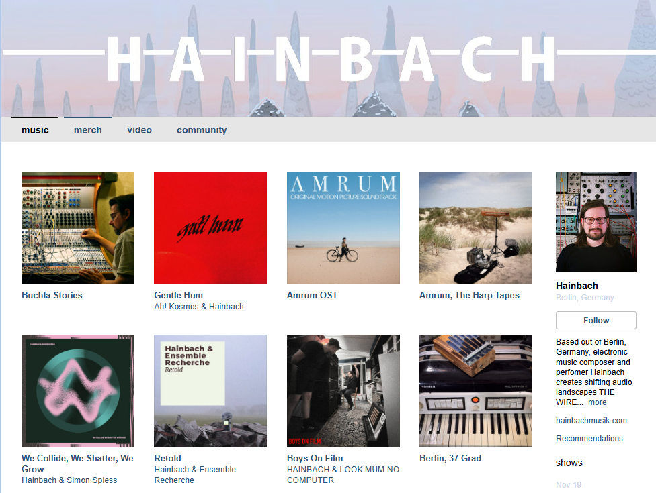
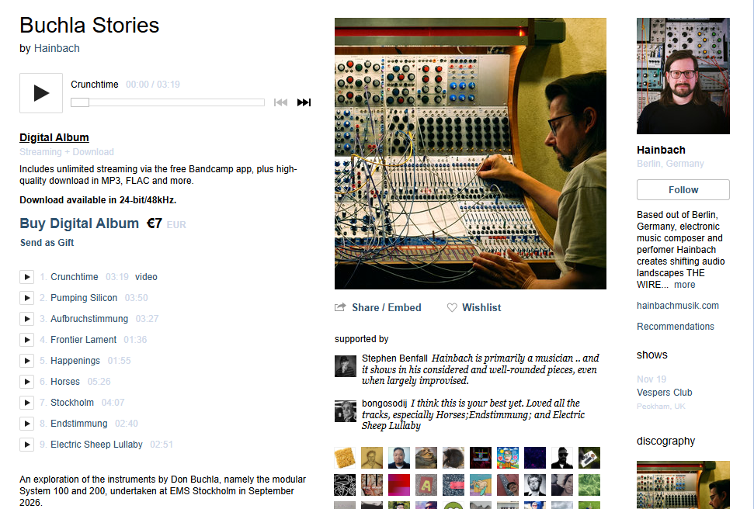
Marketplace Overview & Discovery Challenge
11/36

Slide 17
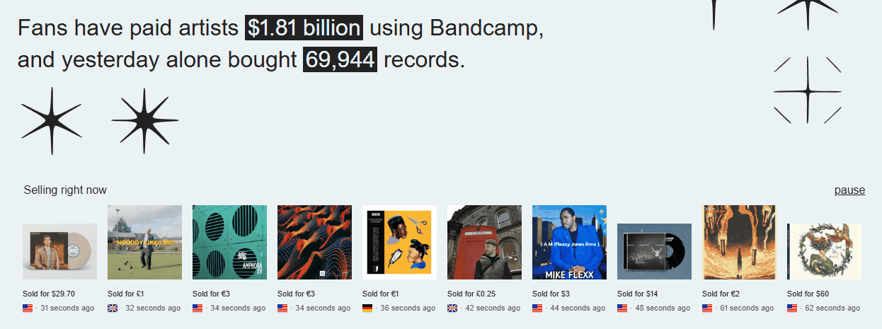
Discovery Channel 1: Platform-wide Visibility
12/36
Random exposure (∼50% of transactions got exposed)
More

Slide 18
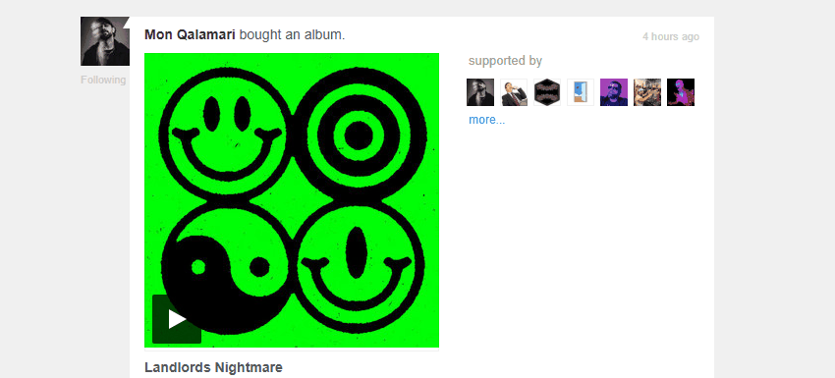
Discovery Channel 2: Network-wide Visibility
13/36

Slide 19
How Do Purchases Lead to Discoverability
14/36
Selected into the homepage live feed
The artist receives a platform-wide visibility
A consumer purchases an album from an artist
The artist receives a network-wide visibility
The consumer has followers

Slide 20
Data
15/36
A four-week period dataset from May 3 to May 30, 2026
Transaction data
  14,812 consumers, 14,646 artists, and 193,553 transactions
Visibility data
  877,730 platform-wide shocks; 785,725 network-wide shocks
Profile data: network (fixed), genre (fixed), inventory (dynamic)

Slide 21
Reduced-form Evidence:
DiD Design

Slide 22
Individual Sales
16/36
Design
We first use a stacked DiD design to identify a short-run effect of visibility shocks on individual artist sales
What is identified? A toy example
  Two artist A1 and A2
  A1 and A2 have no transactions during {-κ, …, -1}
  A1 and A2 both have a transaction at t=0.
  A1’s got exposed, while A2’s didn’t.
  We compute the difference in sales during {1, …, κ -1}

Slide 23
Reduced-form Evidence:
Results
(RQ1, partially)

Slide 24
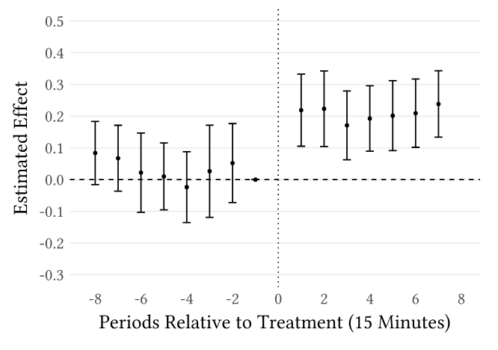
Discovery Channel 1: Platform-wide Visibility
17/36
Desc
Artists whose transactions at t=0 get a platform-wide exposure
vs.
Artists whose transactions at t=0 don’t get exposed
Effect size: 0.180***
Median sales: 7

Slide 25
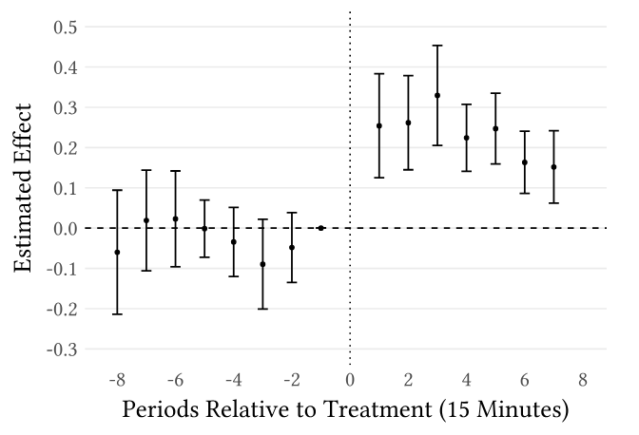
Discovery Channel 2: Network-wide Visibility
18/36
Artists whose transactions at t=0 are made by users with followers
vs.
Artists whose transactions at t=0 are made by users without followers
Effect size: 0.254***

Slide 26
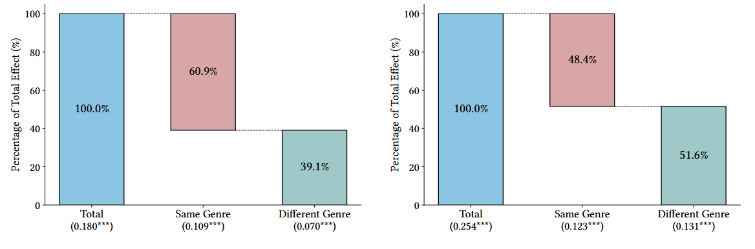
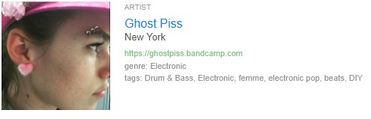
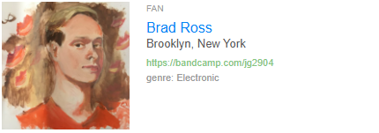
Mechanisms 1: Platform-wide Visibility
19/36
Genre
Decomposition of Platform-wide Visibility

Slide 27
Mechanisms 2: Network-wide Visibility
20/36
Genre
Decomposition of Network-wide Visibility Effect

Slide 28
Concerns on Market Composition
21/36
Decomposition of Platform-wide Visibility
Decomposition of Network-wide Visibility Effect

Slide 29
Discussions
22/36
RQ1: Making purchases visible has positive effects on individual sales
⇒ Is it a zero-sum game?
RQ1: These designs might change the market composition
⇒ Do they harm genre diversity? Consumer welfare?
RQ2: Insights about platform design

Slide 30
Structural Model:
Setup

Slide 31
Modeling Challenges
23/36
High frequency variations (∼0.8 transaction/sec)
⇒ continuous-time setting
Large choice set (∼15K artists)
⇒ encounter then purchase
Unobservable user session
⇒ nonhomogeneous Poisson arrival

Slide 32

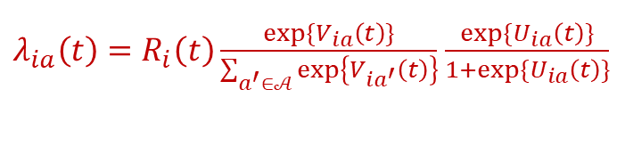
Consumer Decision Process
24/36
Model
1. Ready to explore new music?
Time effect
Inventory effect
2. Which artist to explore?
Visibility (Discoverability)
Connection/Genre match
Random effects
3. Purchase?
Price
Diversity-seeking
Random effects
$λ_{ia}\left(t\right)=R_{i}\left(t\right)\frac{exp⁡\{V_{ia}\left(t\right)\}}{\sum_{a^{′}∈𝒜}{\exp\left\{V_{ia^{′}}\left(t\right)\right\}}}$ $\frac{exp⁡\{U_{ia}\left(t\right)\}}{1+exp⁡\{U_{ia}\left(t\right)\}}$
⇒ Thinning Theorem: A point process
Poisson arrival as readiness
Conditional on arrival, encountering an artist is a discrete choice
Conditional on encounter, consumers decide whether to purchase from the artist
$$R_{i}\left(t\right)=exp⁡\{b_{i}\left(t\right)+η S_{i}(t)\}$$
baseline inventory
$$V_{ia}\left(t\right)=ζ_{1} V_{ia}^{m}\left(t\right)+ζ_{2} V_{ia}^{l}\left(t\right)+ρ Ξ_{ia}+ξ_{ia}\left(t\right)$$
platform-wide network-wide
$$U_{ia}\left(t\right)=α_{1} S_{ig\left(a\right)}\left(t\right)+α_{2} p_{a}(t)+\tilde{ρ} Ξ_{ia}+{\tilde{ξ}}_{ia}\left(t\right)$$
genre share price

Slide 33
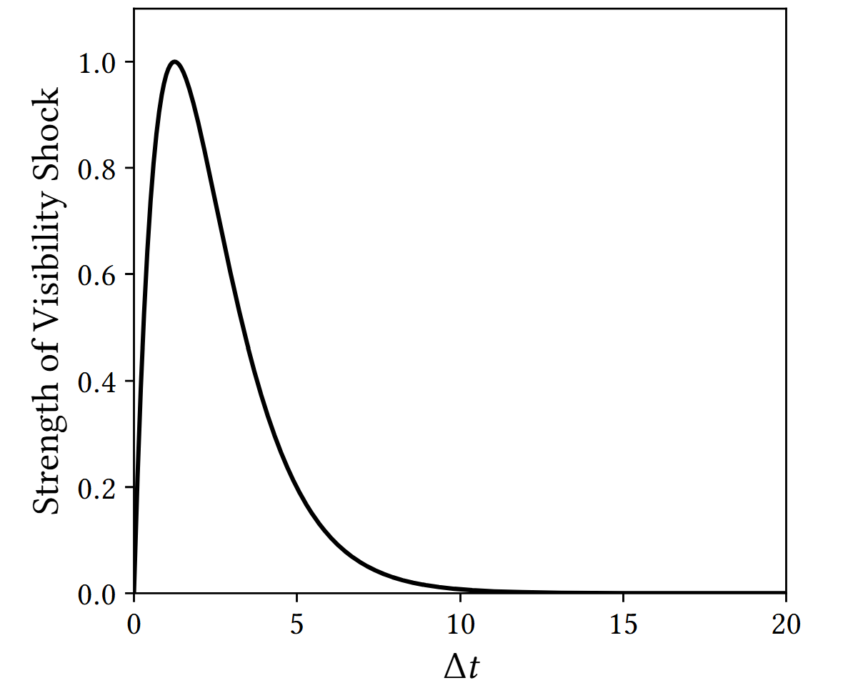
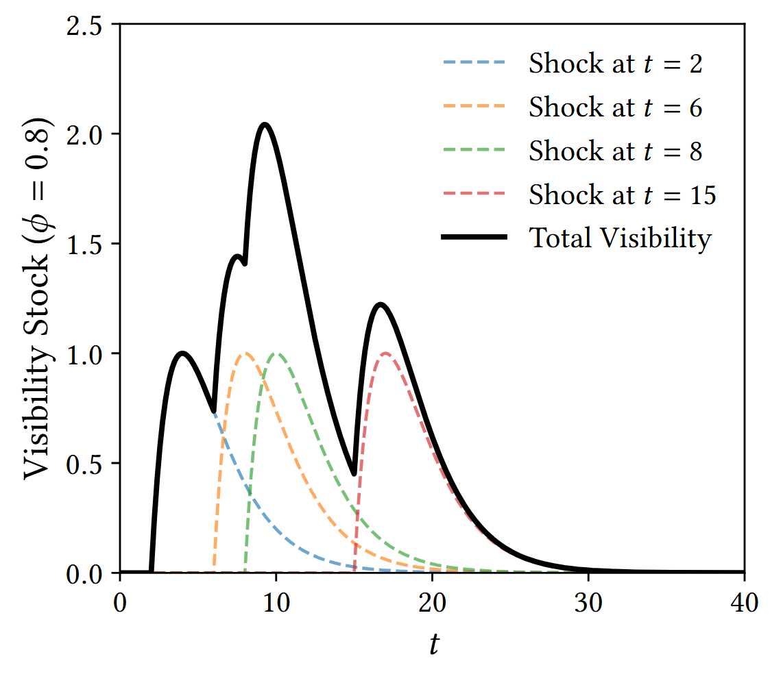
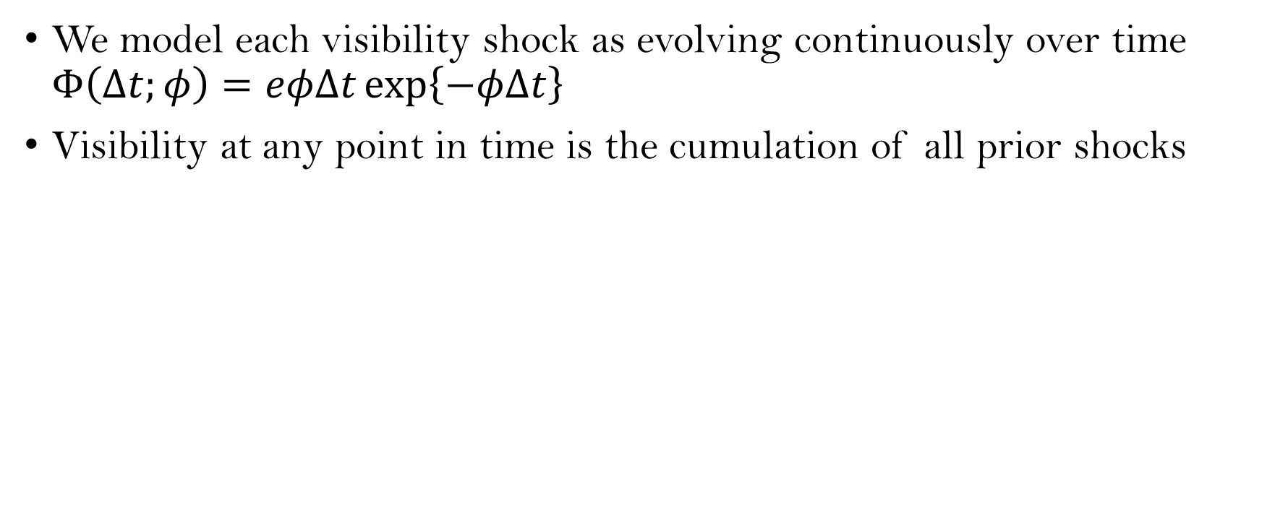
Capture the Evolving Visibility
25/36
We model each visibility shock as evolving continuously over time $Φ\left(Δt;φ\right)=eφΔt\exp\left\{−φΔt\right\}$
Visibility at any point in time is the cumulation of all prior shocks

Slide 34
Estimation
26/36
Detail
Extremum estimators (e.g., MLE) are computationally unaffordable
Neural Network Estimation (Wei and Jiang 2025)
Parameter Set 1
Simulation Outcome 1
Parameter Set 1
Step 1
Step 2
Structural Model
NN
Parameter Set 2
Simulation Outcome 2
Parameter Set 2
……
……
……
Parameter Set L
Simulation Outcome L
Parameter Set L
Step 3
Trained NN
Real outcome (Observed Data)
Parameters of interest

Slide 35
Structural Model:
Validation

Slide 36
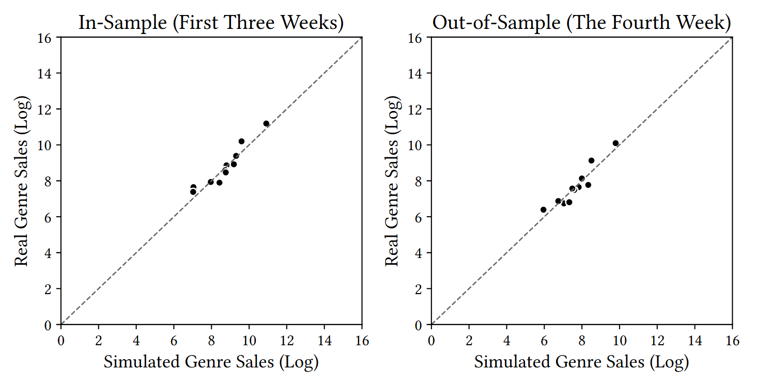
Model Fit (predicted vs. observed genre demand)
27/36
More
Electronic
Other
Electronic
Rock
Other
Experimental
Alternative
Rock
Metal
Experimental
Alternative
Pop
Metal
Jazz
Punk
Pop
Hip-hop/Rap
Jazz
Punk
Ambient
Hip-hop/Rap
Ambient

Slide 37
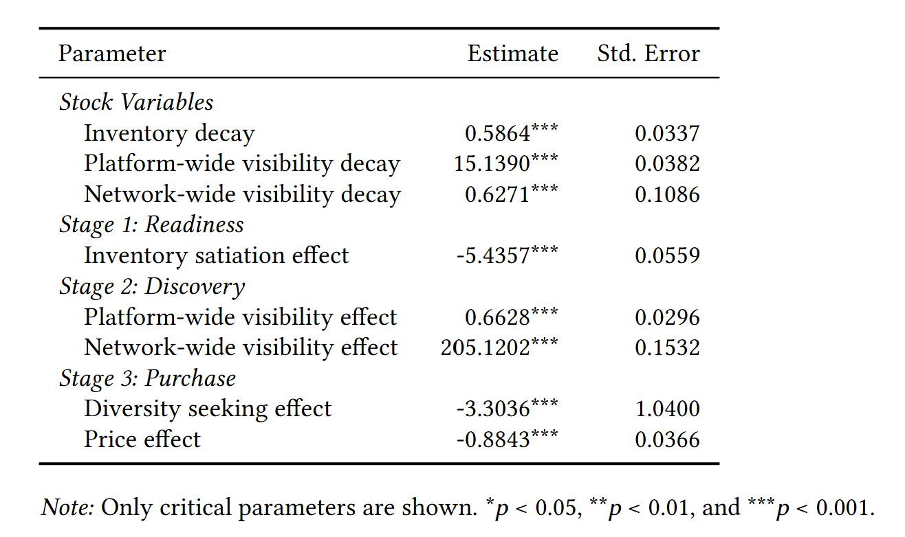
Estimation Results
28/36
Viz

Slide 38
Counterfactual Simulations
29/36
We simulate several scenarios to answer our research questions:
  Blocking platform-wide visibility (RQ1)
  Blocking network-wide visibility (RQ1)
  Blocking both (RQ1&2)
  Alternative platform-wide visibility rules (RQ2)

Slide 39
Structural Model:
Results I
(RQ1)

Slide 40
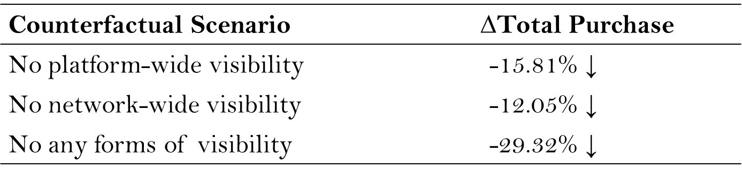
RQ1.1: The Effect of Discovery Channel - Demand
30/36
Counterfactual Scenario | ∆Total Purchase
No platform-wide visibility | -15.81% ↓ ($≈$$1.58M)
No network-wide visibility | -12.05% ↓ ($≈$$1.21M)
No any forms of visibility | -29.32% ↓ ($≈$$2.93M)
Blocking either form of visibility decreases the total demand
Platform-wide visibility has a larger effect

Slide 41
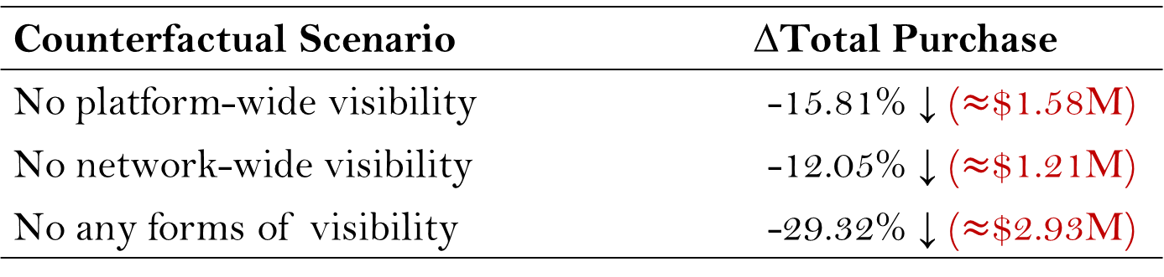
RQ1.1: The Effect of Discovery Channel - Demand
30/36
Sales
Counterfactual Scenario | ∆Total Purchase
No platform-wide visibility | -15.81% ↓ ($≈$$1.58M)
No network-wide visibility | -12.05% ↓ ($≈$$1.21M)
No any forms of visibility | -29.32% ↓ ($≈$$2.93M)
Blocking either form of visibility decreases the total demand
Platform-wide visibility has a larger effect

Slide 42
RQ1.2: The Effect of Discovery Channel - Market Concentration
31/36
Counterfactual Scenario | ∆HHI of Genre Share
No platform-wide visibility | +13.52% ↑
No network-wide visibility | +20.95% ↑
No any forms of visibility | +48.65% ↑
Notes. HHI refers to the Herfindahl-Hirschman Index. HHI↑ ⇒ market concentration↑
Visibility makes consumer purchases more diverse
Network-wide visibility has a larger effect on diverse purchases

Slide 43
RQ1.3: The Effect of Discovery Channel – Consumer Welfare
32/36
Counterfactual Scenario | ∆Entry (Explore) | ∆Total Purchase | ∆Consumer Welfare
No platform-wide visibility | +0.14% | -15.81% ↓ | -15.93% ↓
No network-wide visibility | +0.10% | -12.05% ↓ | -12.14% ↓
No any forms of visibility | +0.25% | -29.32% ↓ | -29.50% ↓
Consumers do not explore more frequently but purchase more
  Discovery becomes more efficient
Consumer welfare increases

Slide 44
Structural Model:
Results II
(RQ2)

Slide 45
RQ2.1: The Design of Discover Channel - Friction
33/36
Counterfactual Scenario | Total Purchase | Consumer Welfare | HHI of Genre Share
No platform-wide visibility | -15.81% | -15.93% | +13.52%
No network-wide visibility | -12.05% | -12.14% | +20.95%
No any forms of visibility | -29.32% | -29.50% | +48.65%
Friction | +1.46% | +1.43% | -14.18%
Gain(platform-wide visibility only) + Gain(network-wide visibility only) > Gain(both)
The friction is small in total purchase and consumer welfare
⇒ should not replace one with another

Slide 46
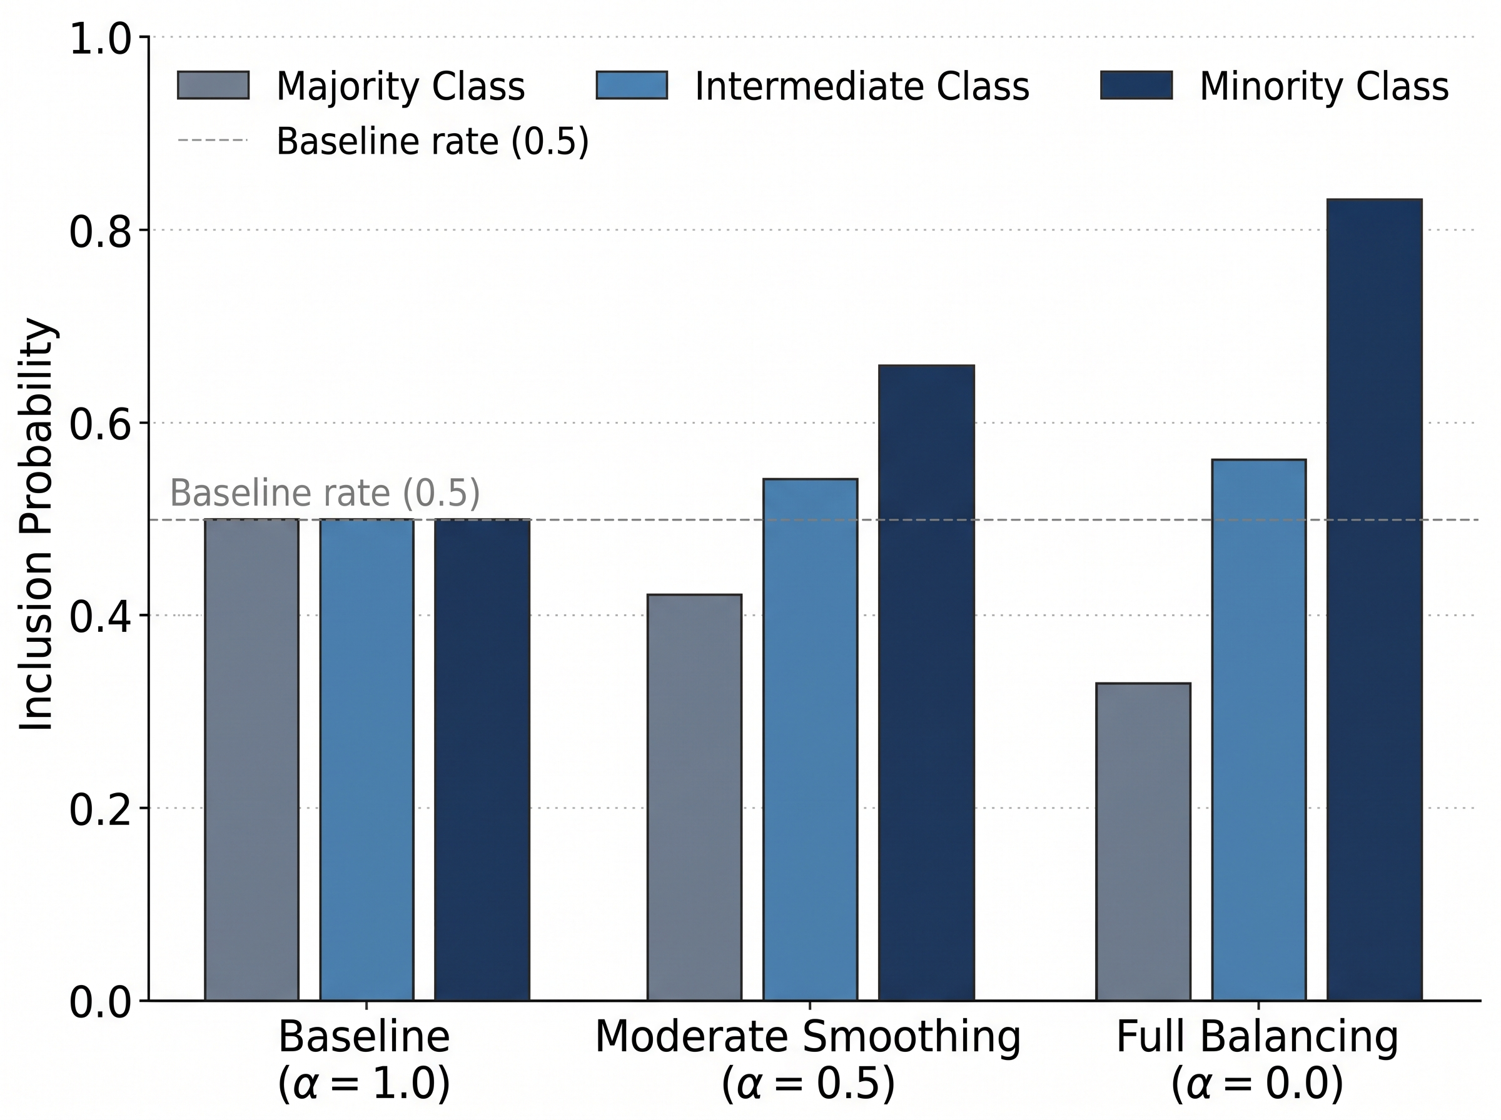
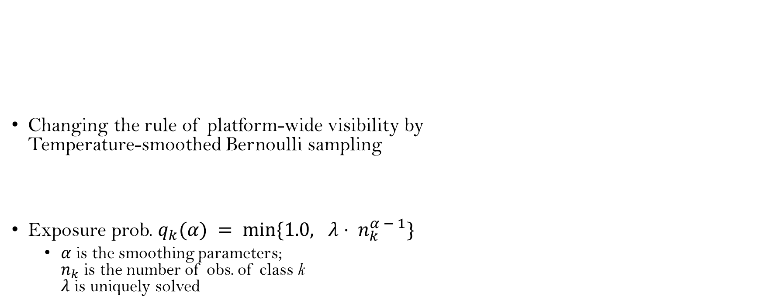
RQ2.2: Alternative Designs
34/36
Changing the rule of platform-wide visibility by
Temperature-smoothed Bernoulli sampling
Exposure prob. $q_{k}(α) = min\{1.0, λ⋅ n_{k}^{α − 1}\}$
  $α$ is the smoothing parameters;
  $n_{k}$ is the number of obs. of class k
  $λ$ is uniquely solved
A Toy Example

Slide 47
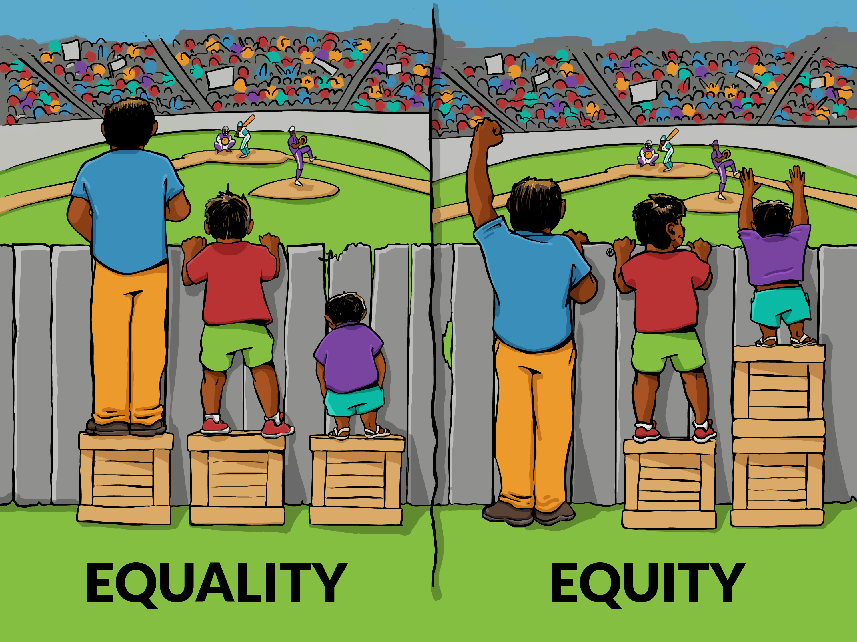
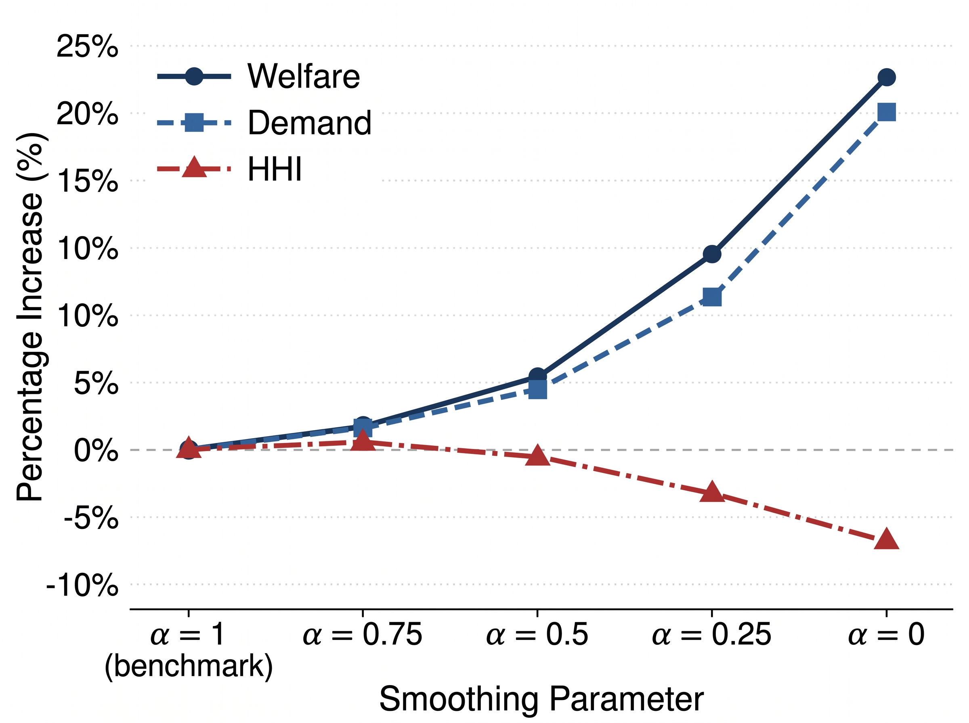
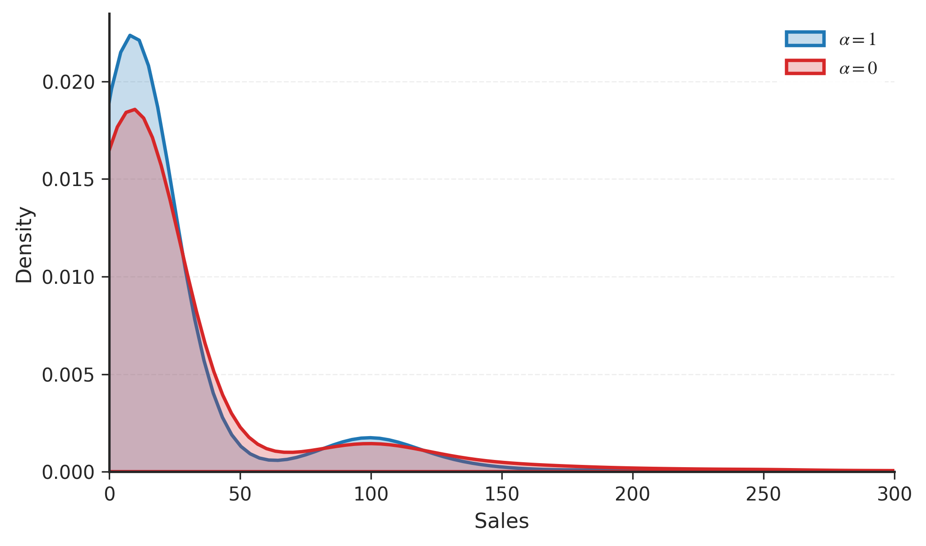


RQ2.2: Alternative Designs
35/36
Outcomes of Counterfactual Designs
Popular
Niche
$$α=1$$
$$α=0$$
Giving niche segments more visibility
further improves market outcomes
Niche transactions get more exposure

Slide 48
Conclusions

Slide 49
Summary
36/36
RQ1: effect of discovery channel
  Improve individual sales (reduced-form)
  Improve market-level outcomes (structural)
RQ2: design of discovery channel
  Different channels have unique contributions (structural)
  Further improvement (structural)

Slide 50
Thank You!

Slide 51
Research Portfolio
 |  | Platform Design |  | Product Development
AI & Machine Learning |  | [1] [7] |  | [2] [4]
Reduced-form Model |  | [1] [6] |  | [2]
Structural Model |  | [1] |  | [4]
Analytical Model |  | [3] [5]
Zijing “Jimmy” Hu, Yan “Lucy” Liu. The value of discoverability and design in direct-to-fan platforms. (Job Market Paper: targeting Marketing Science)
Zijing “Jimmy” Hu, Venkatesh Shankar. Identifying and measuring sales-related underlying product attributes with a new deep learning approach. (Revise & Resubmit, Journal of Marketing Research)
Zijing “Jimmy” Hu, Xuying Zhao. Rejection design for crowdsourcing platforms.
(Accepted at BU Platform Symposium 2025/CIST 2026: targeting Journal of Marketing Research)
Zijing “Jimmy” Hu. Recovering true customer preferences through varying realization probabilities. (Targeting Marketing Science)
Markets for machine demand: API intermediation in the age of AI Agents
Enhancing eco-driving behaviors using offline reinforcement learning
Strategic communication for scientific forecasting

Slide 52
Appendix

Slide 53
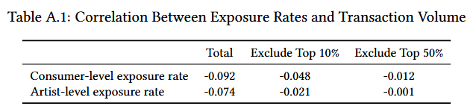
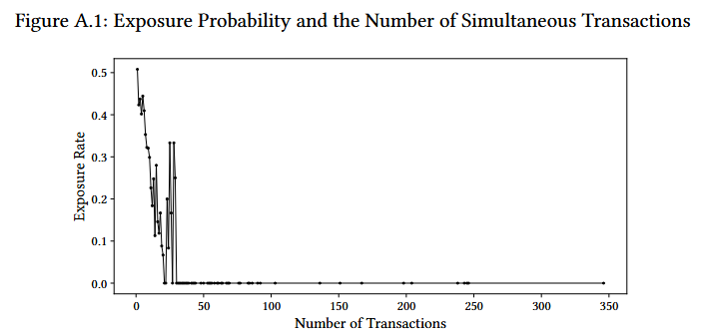
Exposure Rule
Back

Slide 54
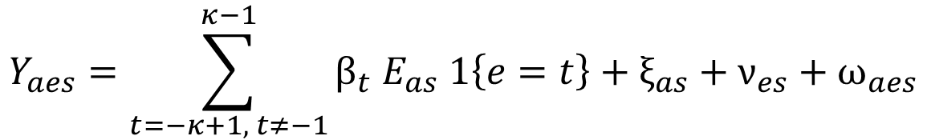
Stacked DiD Design
Back
We use a stacked DiD design to identify a short-run effect of visibility shocks on individual artist sales
  a-artist, e-event time, s-sub-experiment, κ-window size
$$Y_{aes}=\sum_{t=−κ+1, t≠−1}^{κ−1}{β_{t} E_{as} 1\left\{e=t\right\}+ξ_{as}+ν_{es}+ω_{aes}}$$

Slide 55
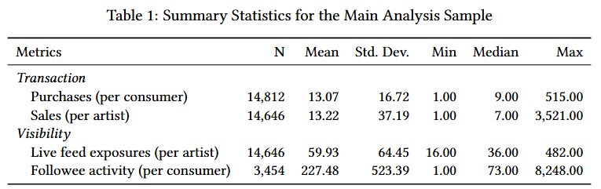
Descriptive Statistics
Back

Slide 56
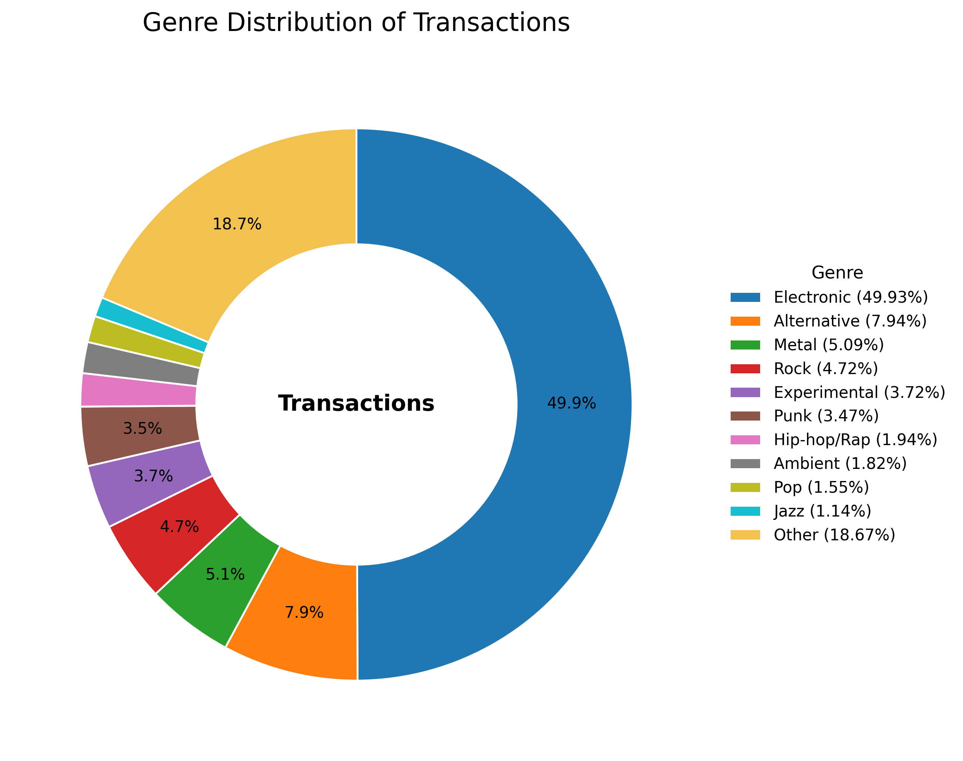
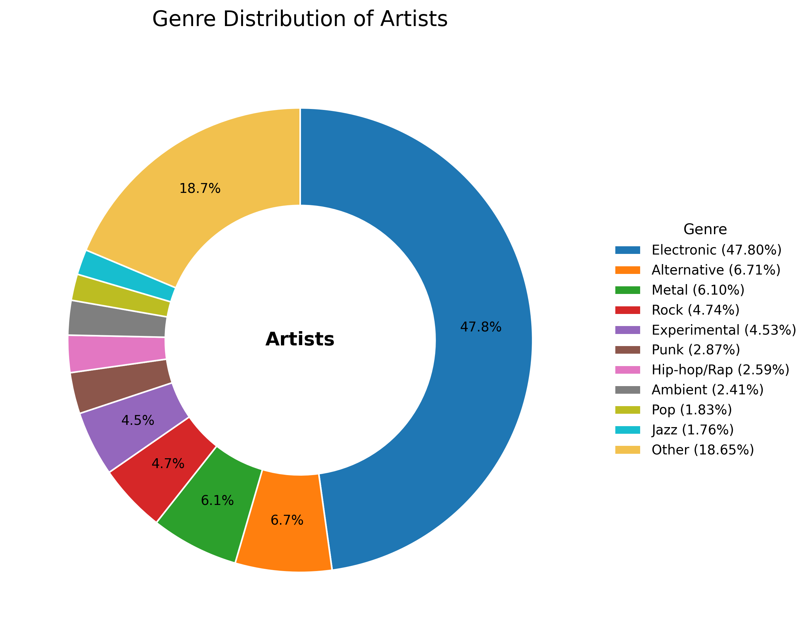
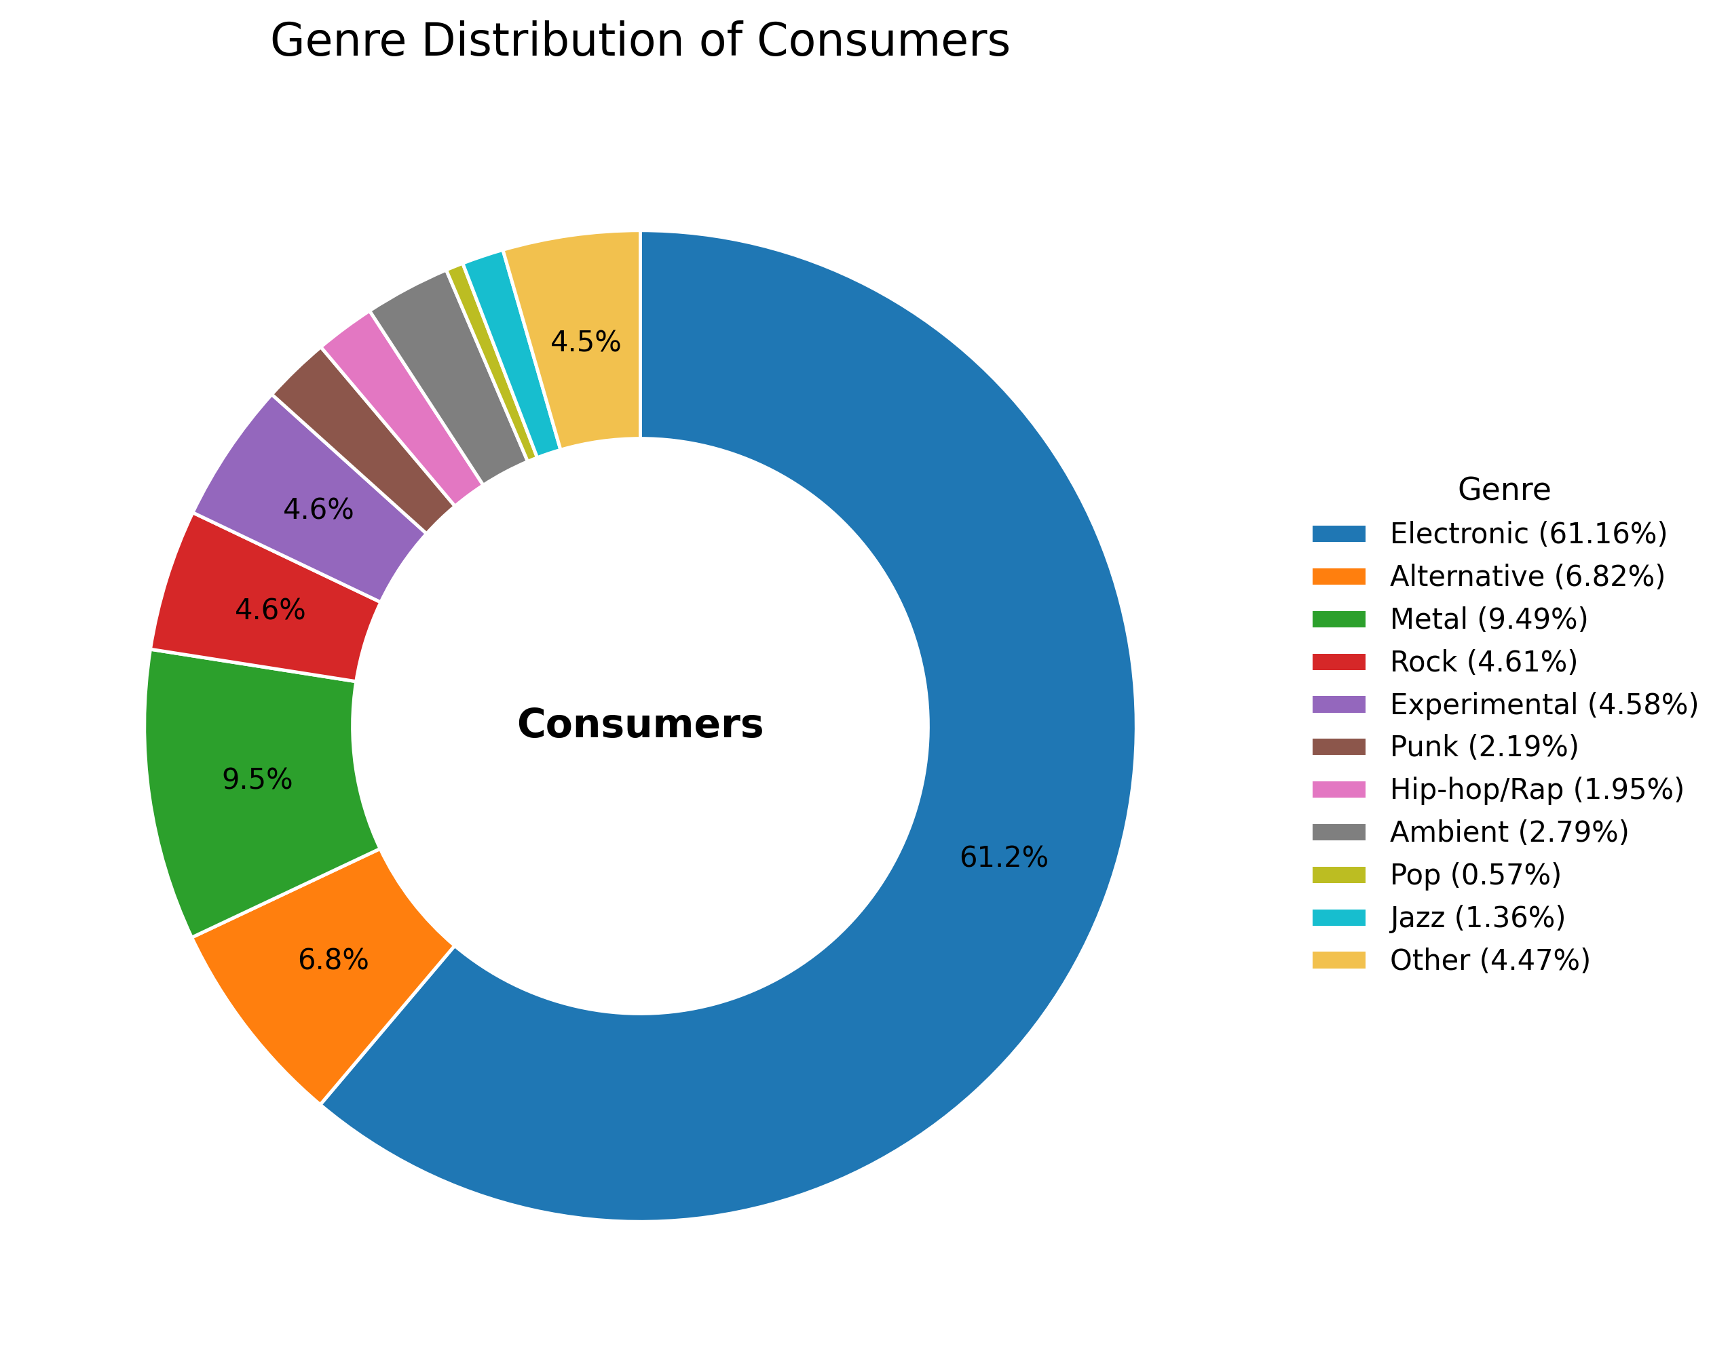
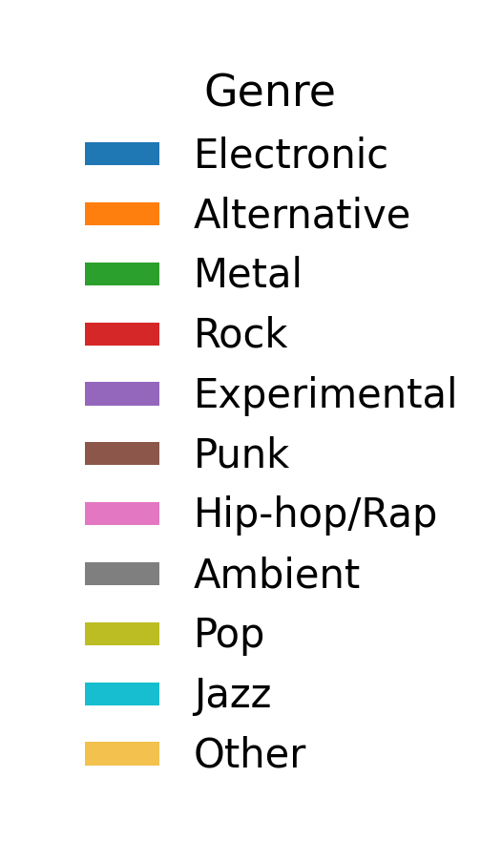
Genre-level Analysis
Back
Consumers and artists can select at most one genre to define themselves

Slide 57
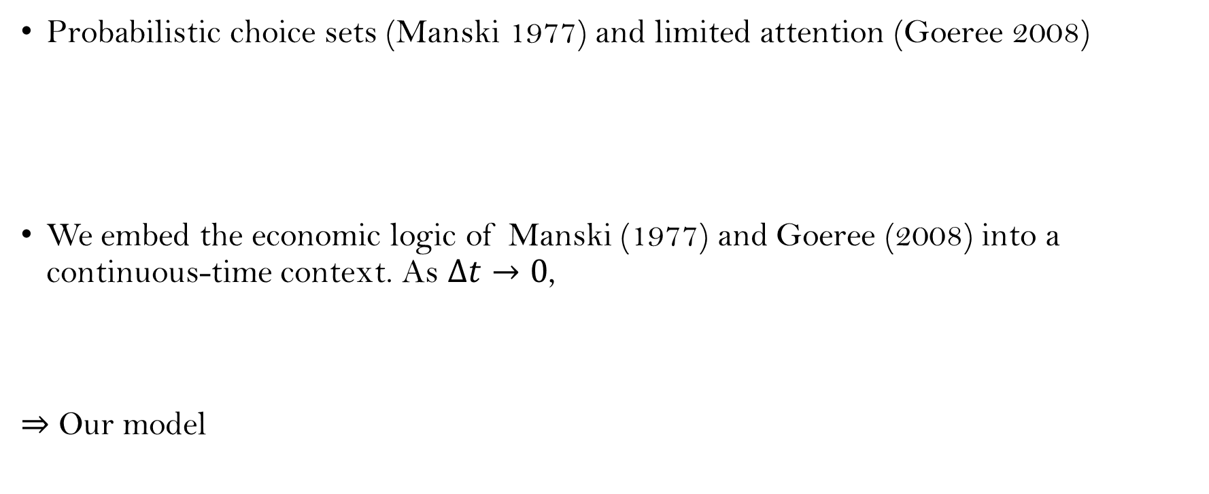
Discussions of Model Formulation
Back
Probabilistic choice sets (Manski 1977) and limited attention (Goeree 2008)
We embed the economic logic of Manski (1977) and Goeree (2008) into a continuous-time context. As $Δt→0$,
⇒ Our model
$$\operatorname{Pr}\left(i buys a in \left[t,t+Δt\right) \right| H_{i}(t))=\sum_{C⊆𝒜:a∈C}{Pr⁡ (C_{i}\left(t,t+Δt\right)=C \left| H_{i}\left(t\right)\right) π_{ia}(C,t)}$$
consideration set conditional choice
$$\operatorname{Pr}\left(i buys a in \left[t,t+Δt\right) \right| H_{i}(t))=R_{i}\left(t\right)\frac{\exp\left\{V_{ia}\left(t\right)\right\}}{\sum_{a^{′}∈𝒜}{\exp\left\{U_{ia^{′}}\left(t\right)\right\}}}π_{ia}(\{a\},t)Δt+o(Δt)$$

Slide 58
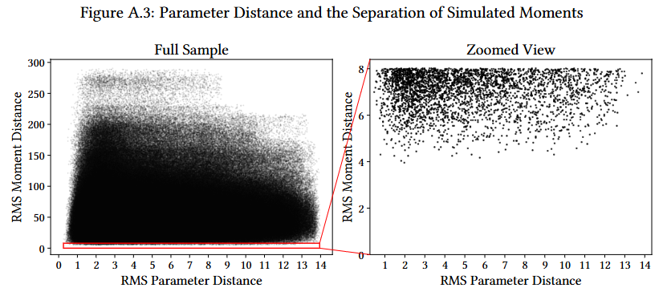
Identification Check
Back

Slide 59
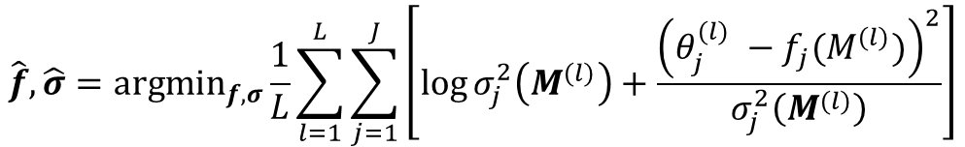
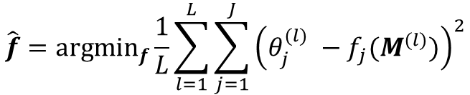
Estimation Process
Back
1. Draw different parameter sets. For each set, simulate (1) arrivals, (2) encounters, and (3) purchases.
2. Train a NN to map simulated demand to the corresponding parameter set.
3. Use the observed demand data as input of the trained NN and obtain the estimation and statistical accuracy.
$$\hat{f}={argmin}_{f}\frac{1}{L}\sum_{l=1}^{L}{\sum_{j=1}^{J}{{\left(θ_{j}^{(l)} −f_{j}(M^{(l)})\right)}^{2}}}$$
Point estimation
Point estimation with statistical accuracy (another NN to predict std.)
$$\hat{f},\hat{σ}={argmin}_{f,σ}\frac{1}{L}\sum_{l=1}^{L}{\sum_{j=1}^{J}{\left[\log{σ_{j}^{2}\left(M^{(l)}\right)}+\frac{{\left(θ_{j}^{(l)} −f_{j}(M^{(l)})\right)}^{2}}{σ_{j}^{2}\left(M^{(l)}\right)}\right]}}$$

Slide 60
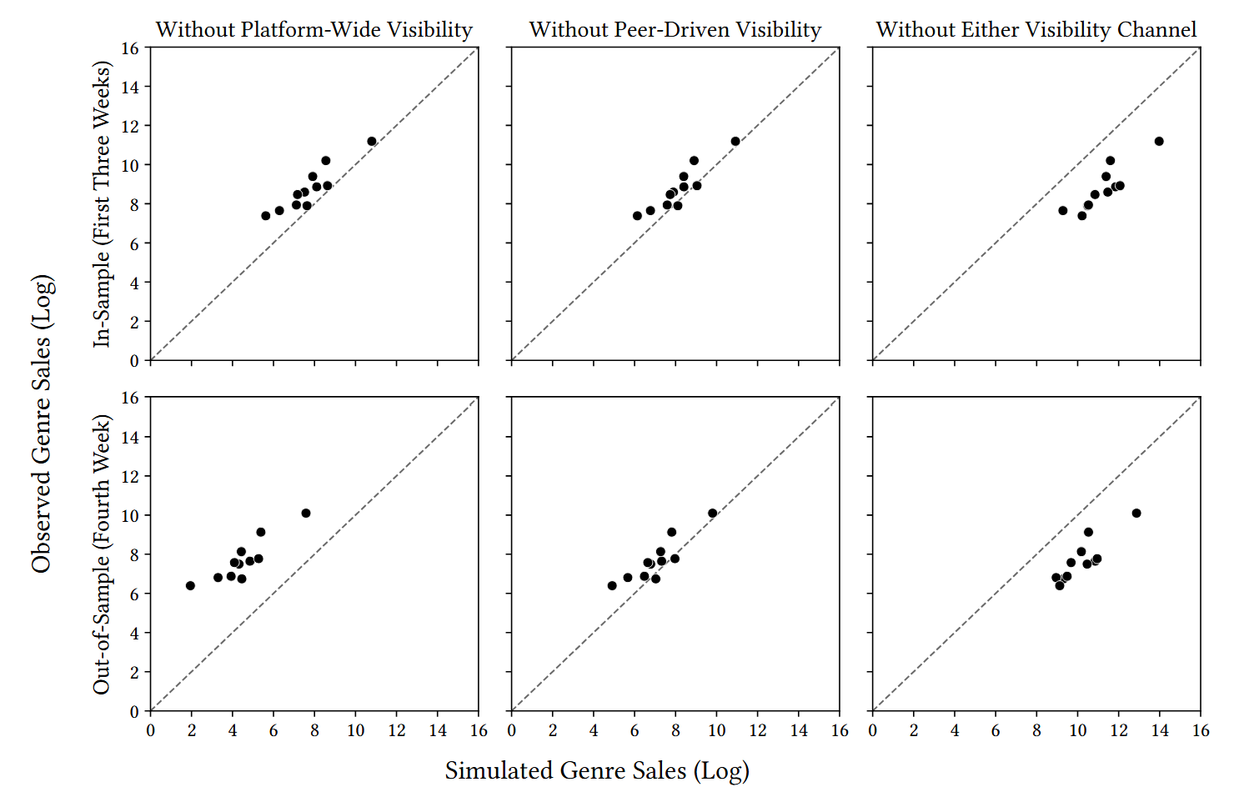
Model Fit (Alternative Settings)
Back
Without Platform-wide Visibility Without Network-wide Visibility Without Both Types of Visibility

Slide 61
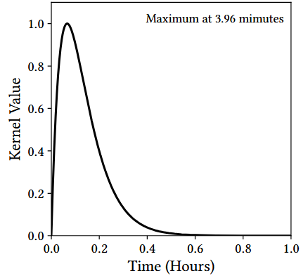
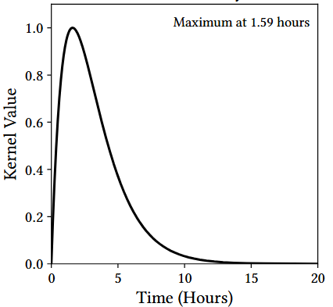
Shapes of Visibility Shocks
Back
Platform-wide Visibility Shock
Network-wide Visibility Shock

Slide 62
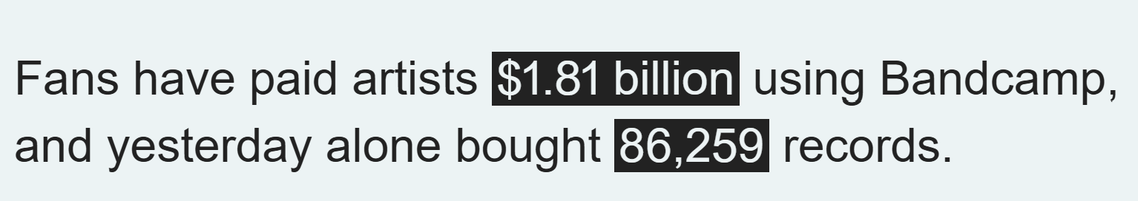
Using Wayback Machine to Infer Total Sales
Back
May 1-May 2: cross $1.72B
May 31-June 1: cross $1.73B
May 3-May 30 (Our analysis period): approximately $10M

